Slide 1


2026
Coordinator & Keyworker
Training

Slide 2

Thank you!
For participating today!!!
For serving!
For your support and enthusiasm!
For inspiring others!
Notes:
Thank you for serving as a volunteer for the State Combined Campaign. You are the most important part of this annual fund-raising effort.
Your support and enthusiasm will be essential to inspiring others to participate so we may make life a little brighter for many of those less fortunate.
Through your eyes, your fellow employees will see the value of the agencies supported, as well as the people who receive help.
This training will help you accomplish this most important mission. Thank you for joining us in this year’s campaign.

Slide 3

Brief Overview of the SCC
In 1991, the Alabama Legislature enacted the Alabama State Employee Combined Charitable Campaign
(Act No. 91-561)
providing Alabama state employees the opportunity to contribute to a multitude of charities through the convenience of payroll deduction. This single convenient channel allows state employees to support their charity of choice while minimizing workplace disruption and administrative cost to Alabama taxpayers.

Slide 4

Getting started
Don’t feel uncomfortable or nervous
You are working for a cause
You are helping to make Alabama a better place for everyone to live and work.
You are the catalyst that makes it happen.
Notes:
Use the “raise your hand” button on Zoom if this your first time serving as a Coordinator or Keyworker for the SCC…
Many people have difficulty getting started with solicitation because they feel uncomfortable asking for donations. This is natural.
Being a SCC Coordinator is nothing to be nervous about…especially when you have THOUSANDS of people behind you! That’s how many folks the SCC helps each year.
Remember, you are not asking for donations for yourself, but for a cause which benefits others every day.
SCC agencies work year-round providing needed solutions to the problems of homelessness, substance abuse, crime, hunger, education, and health issues in your community, across the state, and around the world!
When you ask a co-worker to make a SCC pledge, both of you are helping to make our world a better place for everyone to live and work.
While every person is important to the success of the campaign and every pledge is needed, you are the catalyst that makes it happen.

Slide 5
Definitions
Statewide Coordinator/Co-Coordinator
  Keyworker or Site Coordinator
Statewide Campaign Manager
Local Campaign Manager
Local Agency Review Committee
Steering Committee
Notes:
Statewide Coordinator and Co-Coordinator – Appointed by the department or agency head to be the campaign point of contact for that organization on a statewide basis. Selects key-workers to assist him or her as necessary.
Keyworker – Solicits contributions from individuals in each office. The Coordinator appoints keyworkers. Rule of thumb is one key worker for every 25 employees.
Statewide Campaign Manager – Participating, charitable fundraising federation selected by the Steering Committee to manage the SCC on a statewide basis. The Statewide Campaign Manager will also act as the Montgomery Area Local Campaign Manager.
Local Campaign Manager – Participating, charitable fundraising federation head selected by each LARC, responsible for managing the SCC in a given campaign community. Managers may also be asked to assist the Steering Committee (and the Statewide Campaign Manager) from time to time in the creation and production of necessary campaign materials. A full list of these managers can be found on our website.

Slide 6

Steps to a
Successful Campaign

Slide 7
Why do you volunteer for the SCC each year?
WHAT’S YOUR WHY?
What charities do you personally designate to? Why?
Notes:
Here’s the WHY: we serve to provide state employees with the opportunity to impact their community through giving

Slide 8

Step 1 –
Get Started
Why is the SCC important?
  This is important for you to articulate
Be familiar with materials
Discuss any issues with SCC staff
Notes:
Understand the fundamentals of the campaign. Why is the SCC important? Over 250 charities receive support from contributions made through the SCC; that’s 250 charities that are enabled to do vital work in the community because of people’s generosity. Beyond that, there are many great individual stories from local organizations that continue painting the picture of why the SCC is important.
Attend the Coordinator Training;
Develop your plan, including theme and events to support your campaign;
Establish a campaign timeline that you’re able to publish to everyone
Meet with your Campaign Manager(s) to communicate your strategies to meet your goals.

Slide 9
Step 2 –
Enlist help
Recruit a committee representing all of the divisions/sections within your organization
Your CEO’s enthusiasm and support can be contagious
  Ask him/her to write a personal letter (or email) of support addressed to all employees
Great way to prepare next year’s Coordinator by engaging them this year!
Notes:
Create a winning team by recruiting others to help make your campaign a success;
Meet with your Commissioner, Director or Supervisor and recruit their support of your efforts – the department with the most participation each year are the ones who have the support of their administrators.

Slide 10
Step 3 – Analyze Previous Campaigns
Look at past campaign results
If you are a new coordinator, talk to last year’s coordinator(s)
  What worked well?
  What didn’t work well?
  Is there room for improvement?
Percent of participation or increased average gift
Notes:
A key to fundraising is removing obstacles. Some people like digital materials, some like printed. Use both digital to grab the attention of as many people as possible.

Slide 11
Step 4 – Educate and Inspire
Decide on solicitation style (electronically if necessary)
  Group Solicitation – can be in-person or virtual
  Highly efficient; suggest using speaker (can be done virtually)
  Campaign kickoff
    Show video of Governor and SCC Charity(ies)
Notes:
A key to fundraising is removing obstacles. Some people like digital materials, some like printed. Use both digital to grab the attention of as many people as possible.

Slide 12

Individual (1:1) Solicitation
  Can be done by email or in-person
  Try to personalize email versus bulk email if possible
    Have keyworkers assist
  Offers great opportunity to answer questions
Combined (Individual & Group) – hold one meeting, series of group meetings, and the one-on-one to follow-up with those who could not attend
Take advantage of technology!

Slide 13
Q&A
Type your question in the chat

Slide 14
A Word about Payroll Deduction
All state employees are eligible
Generally, an increase in contribution versus cash/check/credit card gifts
Allows spreading the gift over the entire year
  A small monthly gift can result in a large annual donation
Explain: “It’s a gift you’ll never miss, that someone else will never forget.”
Notes:
All state employees are eligible to make contributions to the State Combined Campaign through payroll deduction.
Since payroll deduction has been made available, a growing number of employees have taken advantage of this easy way of giving. This has resulted in an increase in contributions.
Payroll deduction allows state employees to give a little every month. By spreading the gift over the entire year, a small monthly gift can result in a large annual donation.
Explain it this way: “It’s a gift you’ll never miss, that someone else will never forget.”

Slide 15

Step 5 – Promote
Use employee newsletters, e-mail, and other in-house communication tools (weekly)
Use SCC posters to build awareness and keep everyone involved (and updated) during the campaign (may be digital)
Increase employee awareness by creating friendly competitions between divisions/sections
Use campaign videos and virtual speakers to share the SCC message – video links will be updated on SCC website
Notes:
During the campaign, I will publish a weekly update with how we’re doing overall on our goal. Also contained in that update will be a story from one of our charities about a life they have impacted through their services. I would encourage you to forward this update to your co-workers each week to keep them engaged.

Slide 16

Step 6 – Conduct the Campaign
Set your campaign timeline and internal goals
  Set dates for events
  Kickoff – Aug 20; Campaign ends – Dec 31
Be the first to make your gift
  It is easier to ask others to give when you are giving too! The more personal we make the campaign, the more successful we will be!
Make sure everyone has an opportunity to give!
Notes:
Tell a story about your giving! Why do you designate to the charities that you do? Sharing personal experiences helps others to better relate to the WHY of the campaign.

Slide 17

Step 7 – Report Results
Report as soon as possible, weekly or bi-weekly
Make sure all pledge forms are returned and accounted for
Summarize campaign information on Report Envelope
  Follow envelope instructions and double check totals
Enclose bank verified deposit receipts
SCC will return white copies to payroll (or if digital, one copy)
Call SCC staff with any questions!

Slide 18

Materials

Slide 19
SCC Campaign Guide
PDF Contains:
  Agency Code and Telephone Number
  A description (up to 25-words)
  AFR percentage - % agency spends for fundraising and admin
    30% maximum to participate
Alphabetical listing of all charities
Brochure is by campaign area
ONLINE GIVING GUIDE – a database that allows users to do keyword searches for favorite charity(ies)

Slide 20
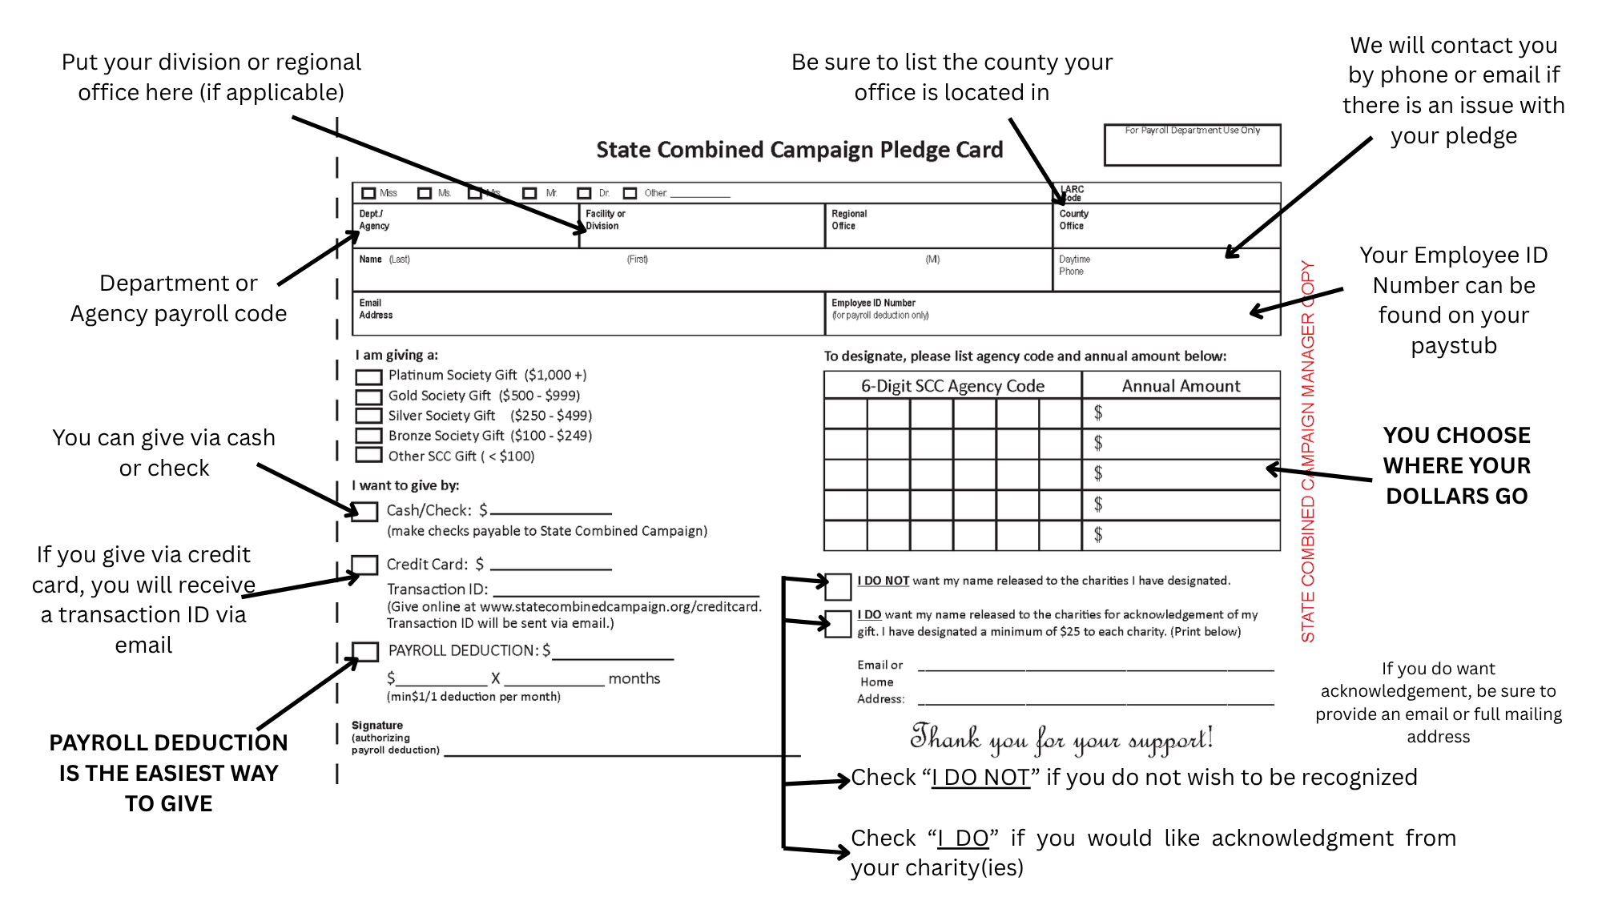


Slide 21
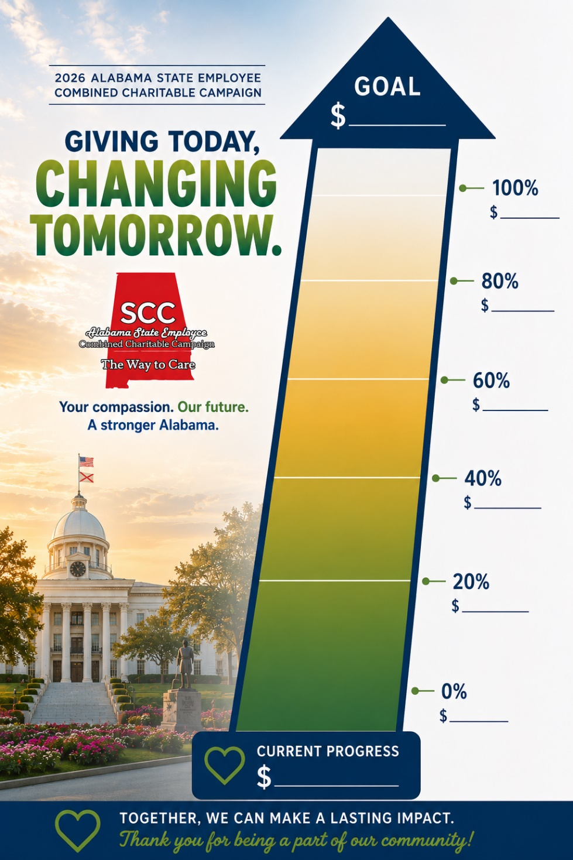
Campaign Poster
You can either set a dollar goal or a participation goal
Post in high-traffic areas
Be sure to update the poster regularly
Notes:
For departments with historically low participation, it may be easier to simply set a participation. This eases the tension for some to feel pressured into giving a certain amount. Remember: any donation is a significant donation!

Slide 22
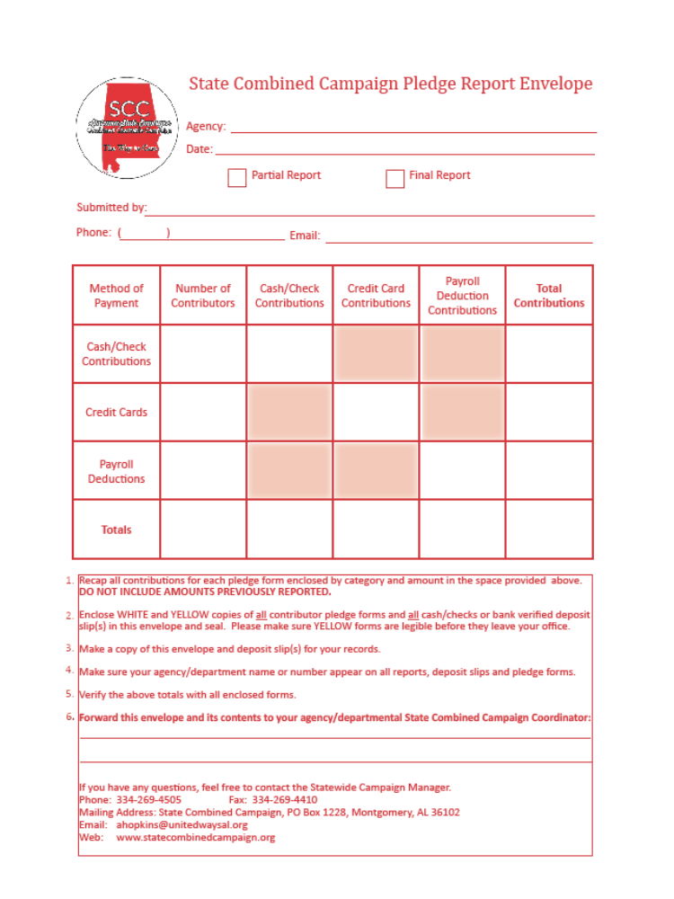
SCC
Envelope
Distribute to keyworkers
Complete ALL information
Use blank to advise keyworkers where to send information

Slide 23
Submitting Your Report
If mailing your report, send to:
PO Box 1228, Montgomery, AL 36102
If dropping off your report, come to:
624 South Perry Street, Montgomery, AL 36104

Slide 24
Q&A
Type your question in the chat

Slide 25
HINTS FOR SUCCESS

Slide 26

BE PREPARED:
Be familiar with materials.
Know how to handle contributions
Know your population
  Don’t leave anyone out!!!
Personalize cards if possible
Notes:
Familiarize yourself with campaign materials.
Know correct procedures for handling cash, checks, and payroll deduction.
Know your target population. Coordinate, talk, visit, coordinate again -- don’t leave anyone out.
Furthermore, get to know the personalities of your co-workers. Some strategies and events that work for some may not work for others. That’s okay! Work with what you have.
If possible, type each person’s name on the pledge card and if they are unable to attend a group campaign meeting, arrange a time to meet with them one on one.

Slide 27

BE ENTHUSIASTIC:
Your sincere, energetic approach is essential to the campaign’s success.
Explain that the agencies participating in the campaign provide a variety of services
  Communicate stories of impact – the WHY
  Agency not listed? Call us first!
Notes:
Your sincere, energetic approach is essential to the campaign’s success.
Be mindful that the potential contributor responds not only to the cause, but also to the way in which it is presented.
Communicate the WHY behind the State Combined Campaign. This campaign is so unique because it pulls together tens of thousands of state employees to raise funds for hundreds of charities. The impact of the donations received through this campaign have such a far-reaching impact. Throughout the campaign this year, we’ve facilitated tours of participating charities. We’ll also be sending out stories from our charities of an individual lives they’ve impacted. We’re doing this so that the SCC doesn’t just become a campaign that do each year, but instead a worthwhile cause of community transformation that we all rally behind. Be intentional about communicating that heart and meaning.
Explain that the agencies participating in the campaign provide a variety of services including: rehabilitation of the physically and mentally challenged, assistance for the aged, youth
programs, food for the hungry, help when we lose loved ones, and help and hope for our friends overseas.

Slide 28

DONOR CHOICE:
Emphasize donor choice.
Only organizations that receive designations will receive funds.
Agency not listed? Call us first!
Notes:
By designating his or her contribution, the donor has complete control over where the contribution goes.
Campaign procedures and audits ensure the donor’s gift reaches the charitable organization he or she designates.

Slide 29

SAY THANKS:
Make sure that you tell every contributor “Thank you.”
Coordinators might consider acknowledging key workers with some form of appreciation such as a thank you note.
Notes:
The Benefits of the SCC…Don’t forget to let them know:
One campaign per year for all agencies assures more dollars for services
A variety of services
Agencies are accountable and must meet standards
Minimizes duplication of services
Payroll deduction makes it easy to give
Tax-deductible contribution enables State Employees to help meet local needs
Financially accountable – CPA audit – Low fundraising and administrative costs
One campaign at the workplace instead of multiple campaigns
You choose where your money goes – designate your dollars
Campaign is run by State Employees for State Employees

Slide 30

REMEMBER -
GIVING IS A PERSONAL MATTER
Gifts to the SCC are voluntary. Whether a person gives to a SCC agency or not may depend on factors other than the worthiness of the charities. Once your prospect is informed about the SCC and understands how it will help others, you have done almost everything you can to influence his/her decision. Remind them they can give $1.00 per month through payroll deduction –
A little each month that won’t be missed will make a difference in the lives of so many!
Notes:
Whether a person gives to a SCC agency or not may depend on factors other than the worthiness of the charities. Once your prospect is informed about the SCC and understands how it will help others, you have done almost everything you can to influence his/her decision.

Slide 31

FUN-DRAISING
Notes:
Now that you are planning your organization’s campaign, it is time to start thinking of ways to make it successful and entertaining. Your Training Guide presents some ideas that have been used successfully by many organizations. These are just some ideas - your ideas do not have to end with the Training Guide.
Use your imagination - put some “fun” in your fundraising.
What do you think will work best in your agency/department? What makes your organization special? Ask some of your co-workers about fundraising ideas. You might be surprised at the many possibilities. Of course, the bottom line is raising money and reaching your campaign fundraising goal. The dollars will help promote over 700 vital health and human service agencies in Alabama and overseas.
We appreciate your efforts in coordination your organization’s campaign and thank you for helping make life better for so many in communities across the state.
Here’s to a successful and rewarding campaign and remember…
why not make it fun!

Slide 32

BRIGHT IDEAS FOR
A REALLY GREAT CAMPAIGN
(found in toolkit)
Build on the Campaign theme
Prizes and/or incentives
Food related events
Sports related events
T-shirt sales

Slide 33
IN PERSON & VIRTUAL EVENT IDEAS:
BINGO | Sell bingo cards to employees and schedule a game. In place of traditional bingo, consider eBingo. Set an amount for each participant to pay to play. Send e-mails sporadically throughout the week with one or two Bingo numbers each time. Use donated prizes for the winners for either version.
CASUAL DAY FUNDRAISER | You’d be amazed by the lengths folks bound to a professional dress code will go to just for the chance to ditch their slacks and wear jeans to the office. Sell Casual Day passes to employees to allow them to dress casually for a day for each pass purchased. You can also have a “Spirit Week” theme. For example, instead of just jeans, try Silly Hat Day, Outrageous Sock Day, or Sports Team Day.
PARKING SPOT FUNDRAISER | Much like the privilege of wearing jeans to work, many employees will do pretty much anything under the sun for a prime parking spot. Finding a nice parking spot in the shade that’s close to the door is the true Holy Grail

Slide 34
SILENT AUCTION-LIVE OR ONLINE | gift card auctions, donations from businesses, etc.
VIRTUAL FOOD DRIVE | Have everyone turn in a pledge form with a donation to a local food pantry instead of a can of food.
CONFERENCE CALL COSTUME CONTEST | Costume will be from neck up – award prizes accordingly (funniest, silliest, unique, etc.)
GREAT OFFICE BAKE-OFF | Like the chili cook off, but with baked goods!
BAKE SALES | Ask for volunteers to donate individually wrapped baked good items. Sell them to co-workers for a good cause.
SCAVENGER HUNT | Have people complete fun challenges that can be done anywhere: take a photo with a stranger, find a specific type of car, or locate random objects around their neighborhood or in a park. This can be a family fun event while social distancing.
ZUMBA CLASS | Invite a Zumba instructor to donate their time and provide people with a fun way to get moving at the end of the day or week

Slide 35

Online Quizzes | Survey Monkey and other sites have free online quizzes and other activities. Have prizes for the individual who has the highest score.
Remember…
Special Events can be time consuming, so whenever possible, ask for help from your colleagues and keyworkers. Delegate specific tasks to be completed by a certain time, and always remember to thank volunteers for their time and energy!
Remember to consider the rules for SCC Special Events (is it legal?). Games of chance are not allowed – that is generally considered a type of gambling. Sweepstakes (no purchase necessary) are allowed. Games of skill are always encouraged (i.e. tournaments, guess the quantity in the jar, Golf Scrambles, etc.). If you have any questions, please call the SCC Manager’s office at 334-269-4505!

Slide 36
What’s your favorite
fundraiser to do?

Slide 37
HAVE A FUN-DRAISING IDEA?
SEND IT TO US AND WE’LL POST IT ON OUR WEBSITE!

Slide 38

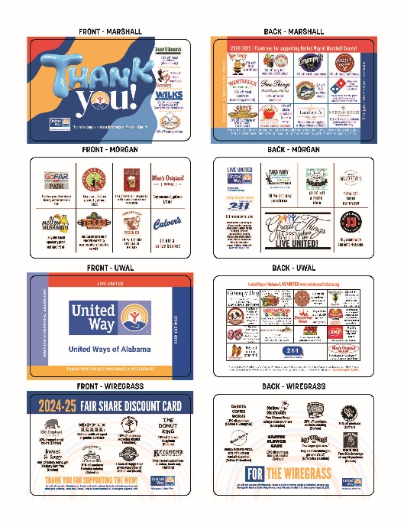
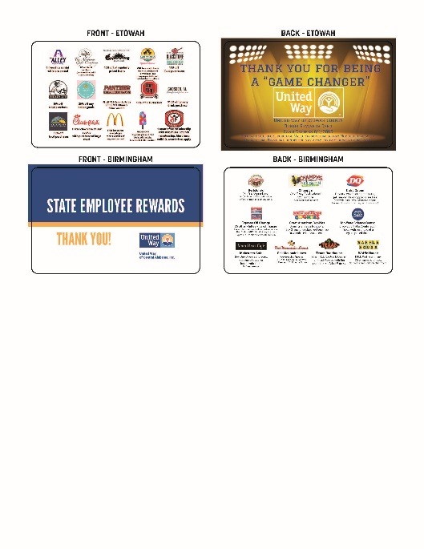
Incentives

Slide 39
Discount Cards
For a gift of at least $48
  Montgomery Area
  Marshall County
  Morgan County
  Tuscaloosa Area
  Lake Martin Area
  East Central Alabama (Calhoun, Cleburne)
  East Central AL (Randolph)
  Etowah County
  Madison County
  Wiregrass Area

Slide 40
Q&A
Type your question in the chat

Slide 41
Website Tour www.statecombinedcampaign.org

Slide 42
THANK YOU!

